Slide 1
Project Exit
A first person escape room videogame

Slide 2
Hendrik Wendt

Slide 3
Jonas Beck

Slide 4
Jasmin Smyczek

Slide 5
Franziska Melzl

Slide 6
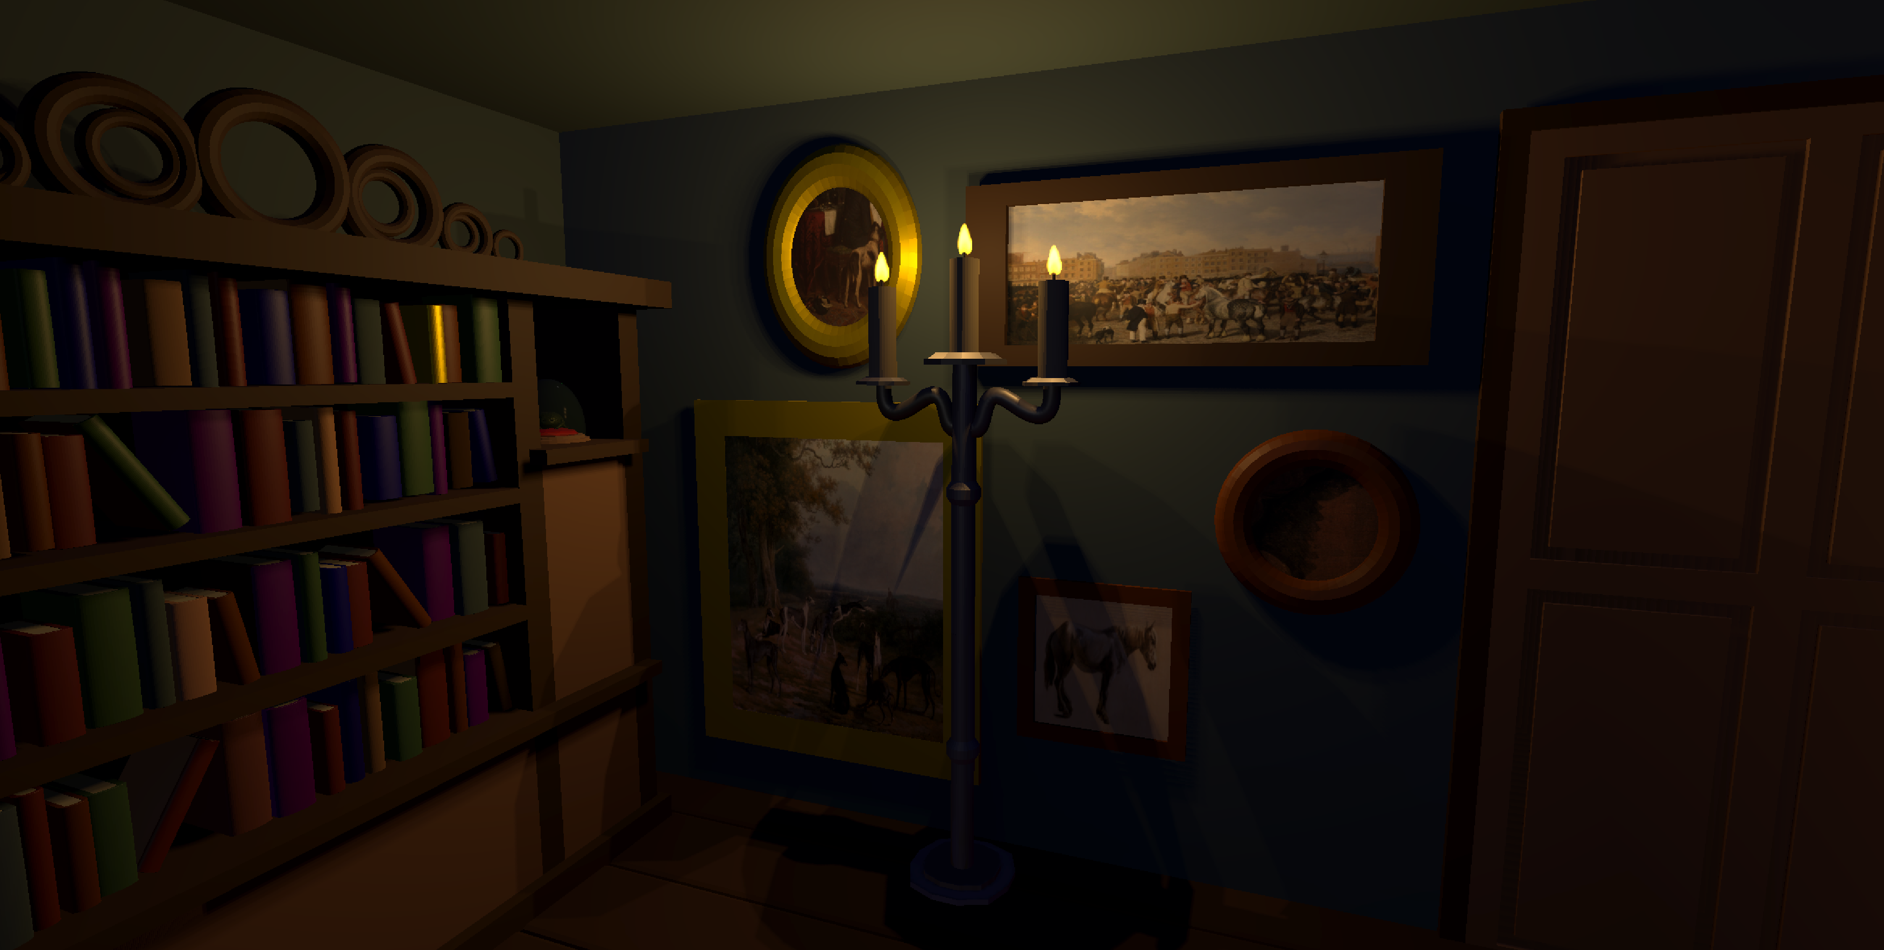
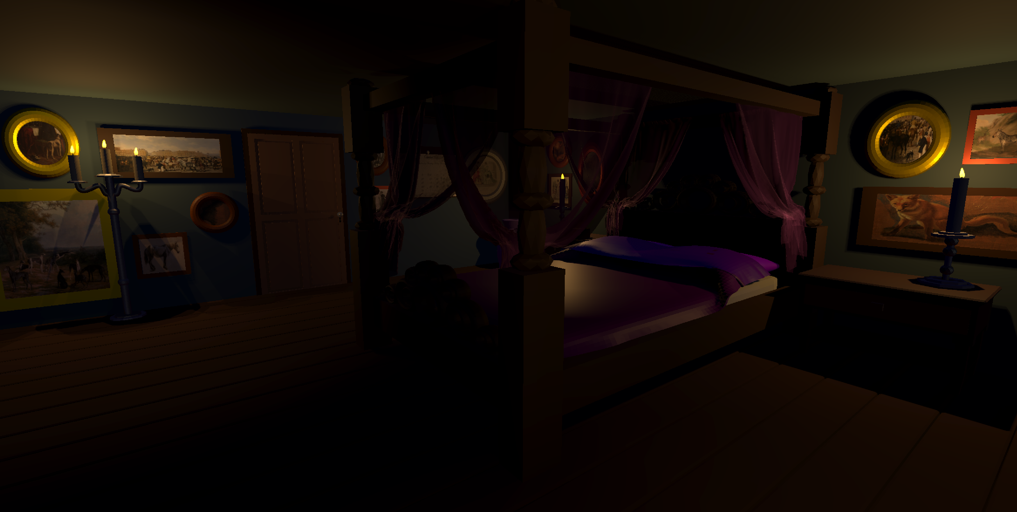

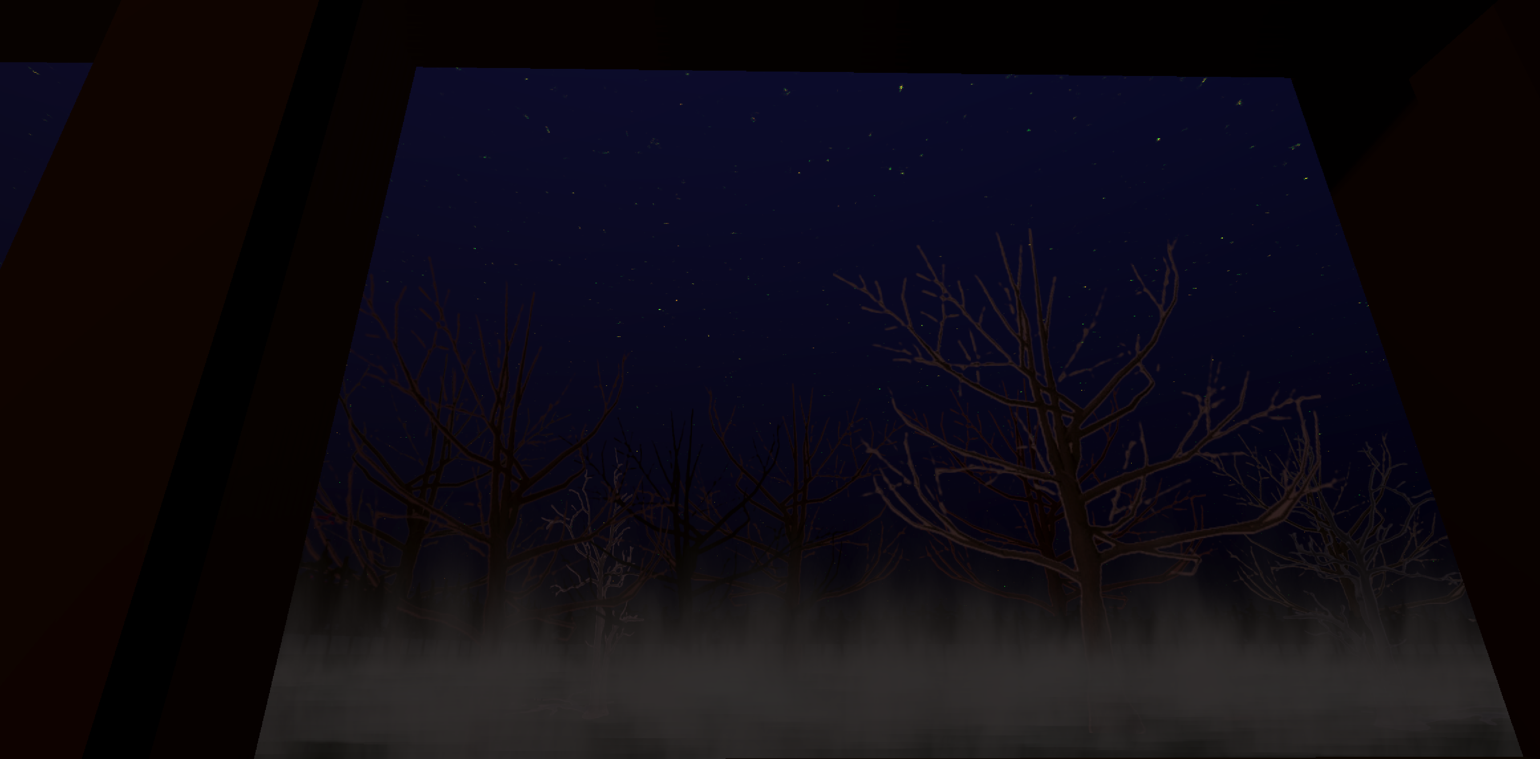
Lena Weilandt

